Slide 1




Marketing Analytics Projects | Intarget Lab
Samaher Brahem | Franco Bonifacini | MohammedHadi ShahHosseini | Pooya Sabbagh
June 2024 @ The University of Milan

Slide 2





The goal is to build a data driven attribution model to assign credits to Channels related to total conversions and to compare with the Last Click model
MARKETING
ATTRIBUTION
What We Will Discuss
Your challenges, our solutions.
The goal is to cluster users based on the data provided in the table “orders”
CUSTOMER
SEGMENTATION
The goal is to build a model to predict the Customer Churn probability for the customers based on the available data
CHURN RATE
PREDICTION

Slide 3


1
MARKETING ATTRIBUTION

Slide 4

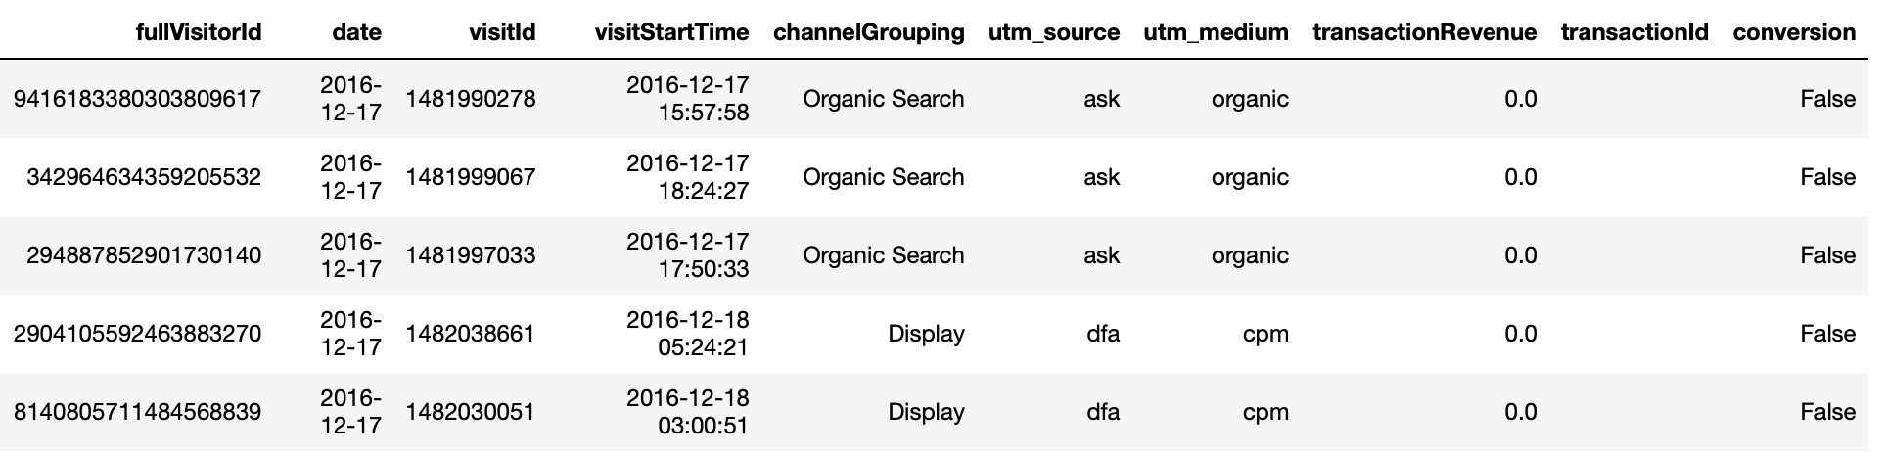
Handling Missing Values
We replaced missing values in the `transactionRevenue` and `transactionId` columns with appropriate default values.
Encoding conversions
We added a new column `conversion`, which indicates whether a conversion occurred for each entry. It sets the value to True if the `transactionRevenue` is greater than zero, indicating a revenue-generating transaction. If not, it sets the value to False, indicating no conversion.
DATA PREPROCESSING
Converting to Proper Types
We converted the values in the `visitStartTime` column from Unix timestamps to a human-readable datetime format, allowing for easier manipulation and analysis of date and time information within the DataFrame.

Slide 5
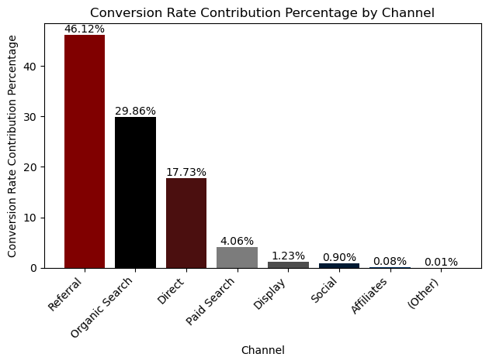
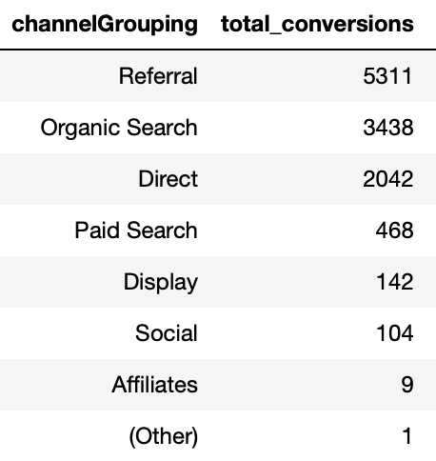
EXPLORATORY DATA
ANALYSIS
903 653
visits
11 515
conversions
Conversion Rate: 1.27%
The Referral channel contributes the most to the total conversions, accounting for 46.12% of all conversions. Organic Search is the second largest contributor with 29.86%, followed by Direct with 17.73%. Paid Search channels contribute 4.06% to the total conversions. The Display channel accounts for 1.23%, and Social contributes 0.90%. Affiliates have a minimal contribution of 0.08%.

Slide 6
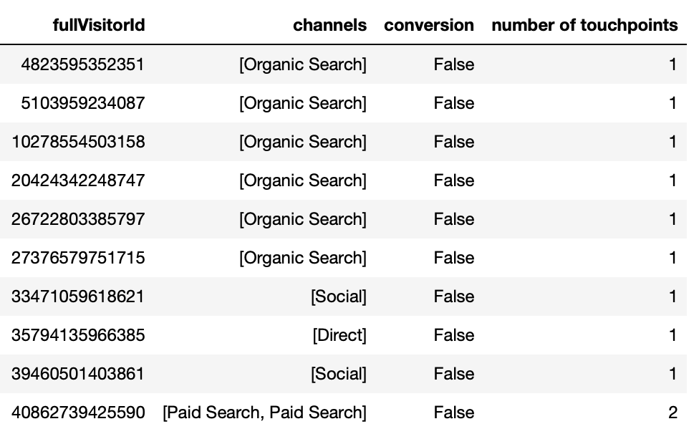
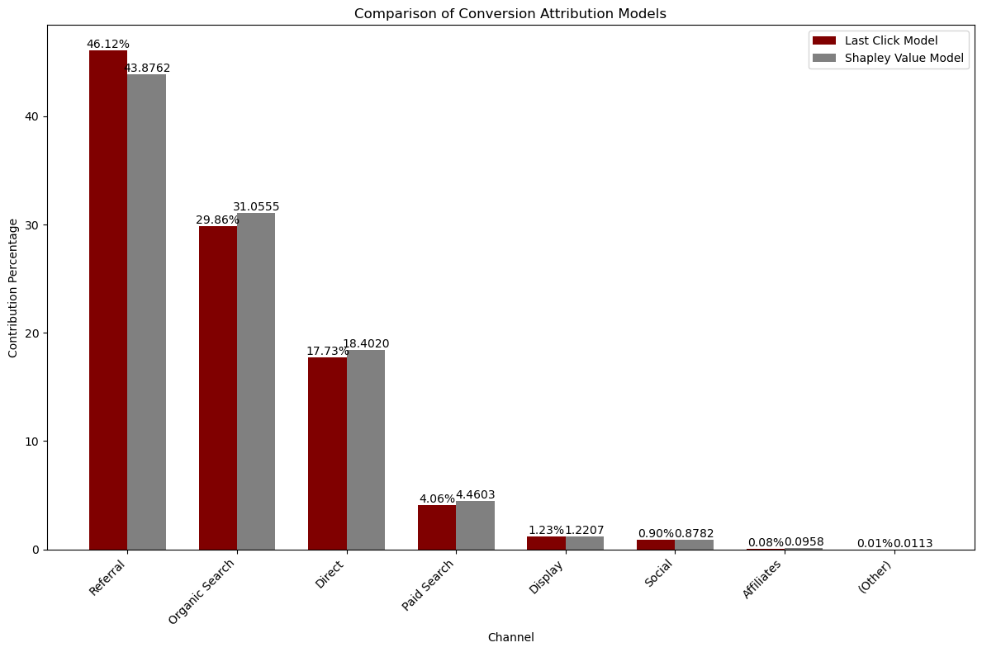

What it is?
The Shapley Value is a method from cooperative game theory used to fairly distribute the total gain (or payoff) among players based on their contributions. In marketing attribution, the "players" are different marketing channels or touchpoints that a user interacts with before converting.
SHAPLEY VALUE
MODEL
How it works?
Identify All Touchpoints.
Calculate Marginal Contribution.
Calculate Average Contributions.
Distribute Credit.
Conﬁdential content

Slide 7
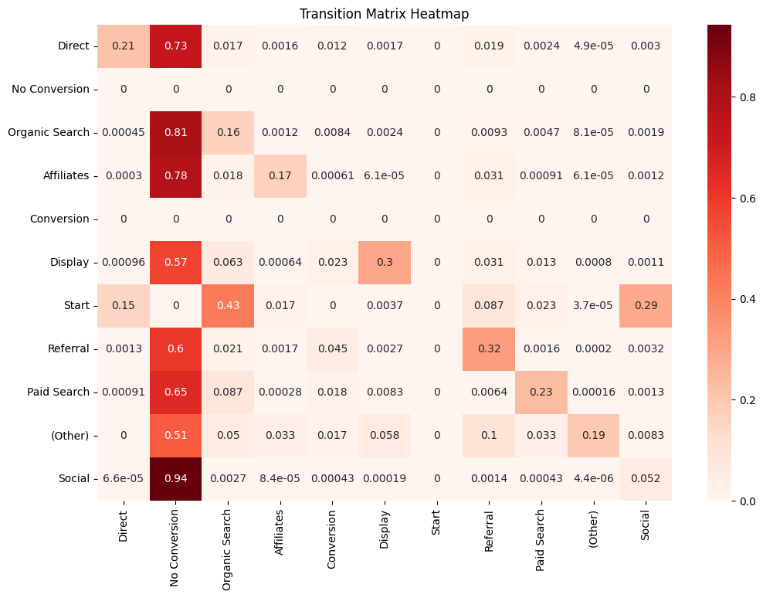
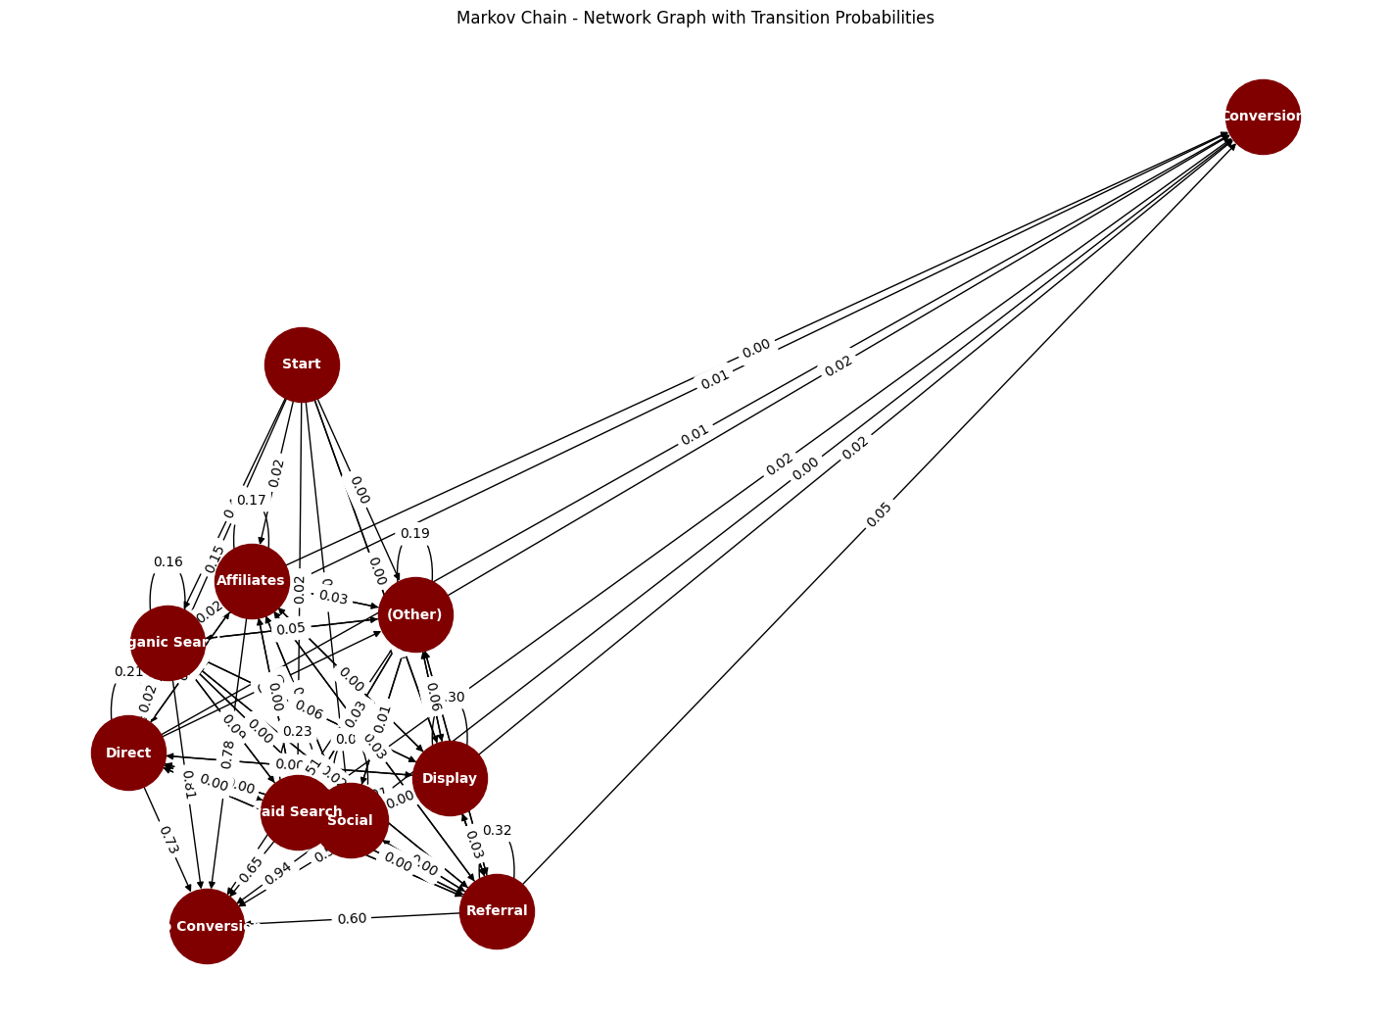
What it is?
Markov chain attribution models credit marketing touchpoints based on the likelihood of a customer moving from one touchpoint to another before converting. They analyze sequential interactions to evaluate each touchpoint's influence on conversion, offering insights into channel effectiveness.
DATA-DRIVEN (MARKOV CHAIN)
MODEL
How it works?
Define touchpoint sequence
Calculate transition probabilities
Construct Markov chain model
Apply to customer journeys
Optimize marketing strategies
Conﬁdential content

Slide 8
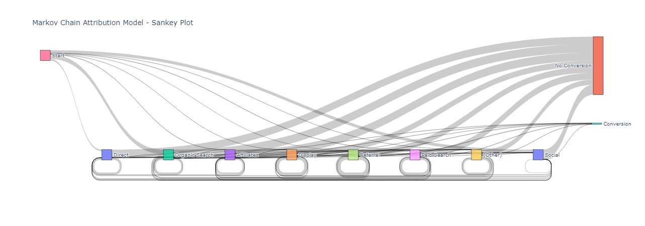
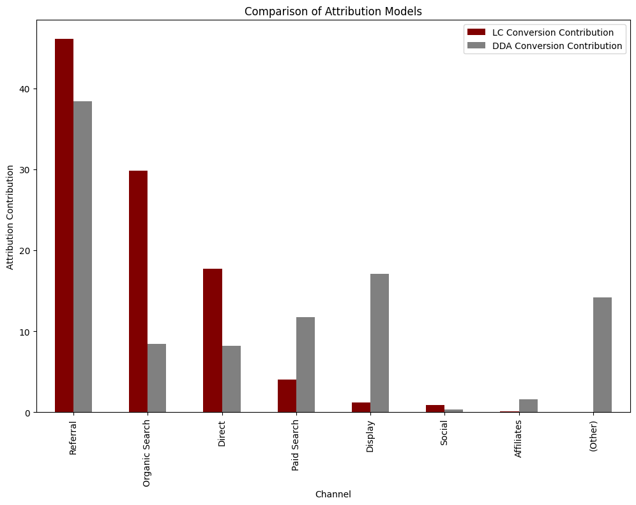
DATA-DRIVEN (MARKOV CHAIN)
MODEL
Comparison
Conﬁdential content

Slide 9
2
CUSTOMER SEGMENTATION

Slide 10
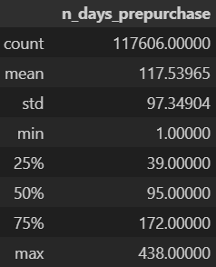
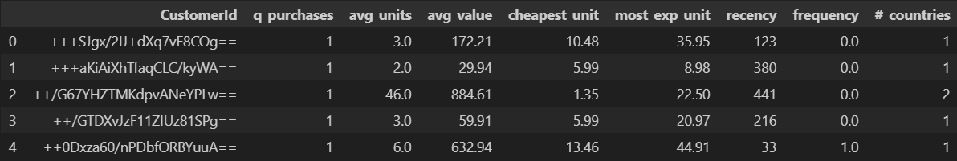
Final variables
q_purchases: number of purchases by customer
avg_units: average units per purchase
avg_value (monetary): average value per purchase
cheapest_unit: cheapest unit bought by customers
most_exp_unit: most expensive unit bought by customers
recency: last purchase counting from last day of March 2022
frequency: number of purchases in a time window of 3 months
#_countries: number of countries where customers bought
Handling Missing Values
Cases where price per unit is 0: this cases were deleted for the project, nevertheless in a daily job is recommendable to check why (usually are cases with gifts or discounts)
DATA PREPROCESSING

Slide 11
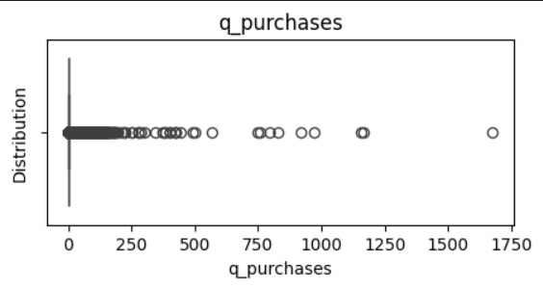
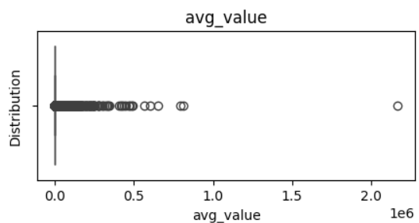
EXPLORATORY DATA
ANALYSIS
Although most variables have outliers, we considered that they are important if and only if the distance between other values is not significant.
Cases where the distance with the next nearest value is considerably high, then they were dropped.
Nevertheless, in a daily job it will be highly recommended to analyze in detail this outliers as they may be interesting customers.
Finally, as variables were not normally distributed, for clustering we used standard normalization, as it outputted the best results when clustering.
The different normalization methods we used and compare were:
MaxMin.
Standard (meand and std).
Applying log to the variables.
DROPPED
>500: 11 records dropped.
DROPPED
>500.000: 6 records dropped.

Slide 12
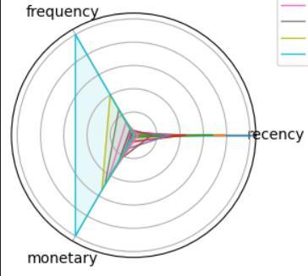
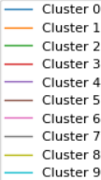
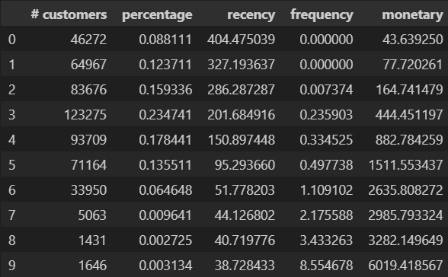
RFM
MODEL
RFM Quartiles
RFM Score
Polar Plot
Cut the dataset into quartiles for each variable:
recency (lower values is preferred)
frequency (higher values is preferred)
monetary (higher values is preferred)
Sum the three values obtained by customer.
This is the RFM Score:
Lower score means a valuable customer = retain.
Higher score means low-value customers = opportunity.
Visual plot with the resulting clusters.
Using a polar plot helps to better differentiate the customers according to their characteristics.
RFM CLUSTERS
Conﬁdential content

Slide 13
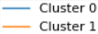
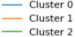
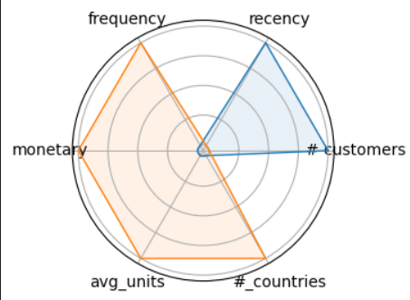
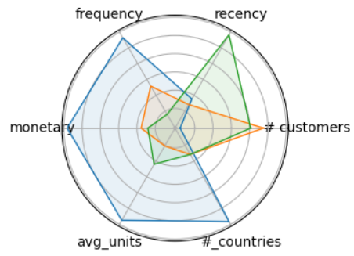
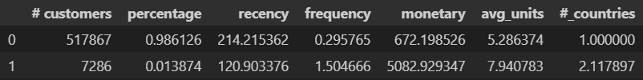
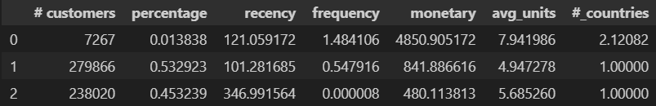
K-MEAN
MODEL
Define variables
K Definition
Clustering Plot
For this model some comparisons were done:
RFM: using same variables as before, but RFM cluster provided a better result.
RFM+Variables: add avg_units, #_countries.
To define number of clusters (k) an elbow and silhouette method were done.
cheapest_unit and most_exp_unit were excluded because of low silhouette score.
Optimal K were 2 and 3 (same score).
When clustering, the final conclusion was:
For a first marketing plan, K=2 is enough.
K=3 should be used for a second step.
RFM clustering is recommended for more detailed plans.
K=2 CLUSTER
K=3 CLUSTER
Conﬁdential content

Slide 14
3
CHURN RATE PREDICTION

Slide 15
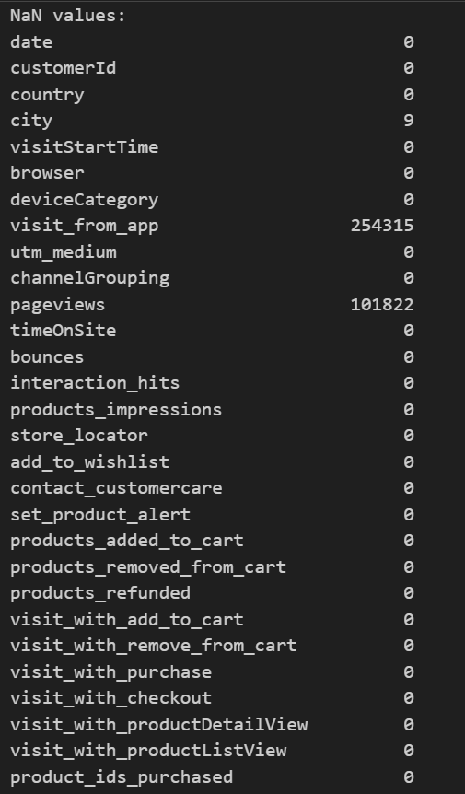
Handling Missing Values
We replaced missing values in the dataset using 0 for numerical values where it made sense and False for boolean values. we had a tremendous amount of NaN in pageviews column which we couldn’t replace with zero because some of the belonged to customers with purchases.
DATA PREPROCESSING
Converting to Proper Types
We converted the values in the `date` column from objects to a datetime format, allowing for easier manipulation and analysis of date and time information within the DataFrame.
grouping by unique IDs
We observed multiple values in the `customerId` column with the same Id from different instances , we grouped them using methods such as min, max and mean, enabling us to create a clean data for the necessary analysis.

Slide 16
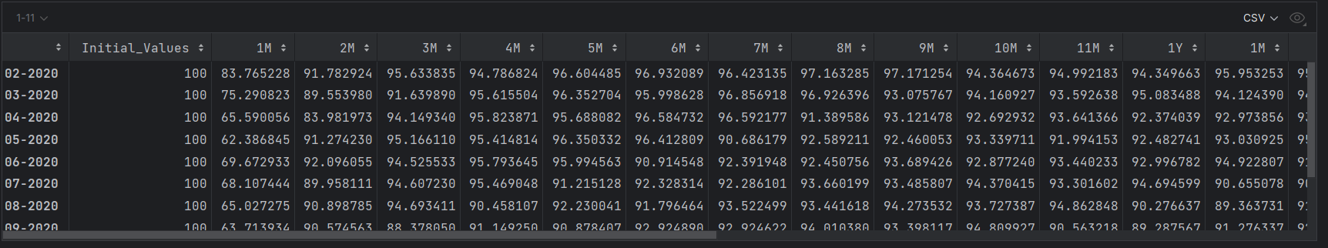
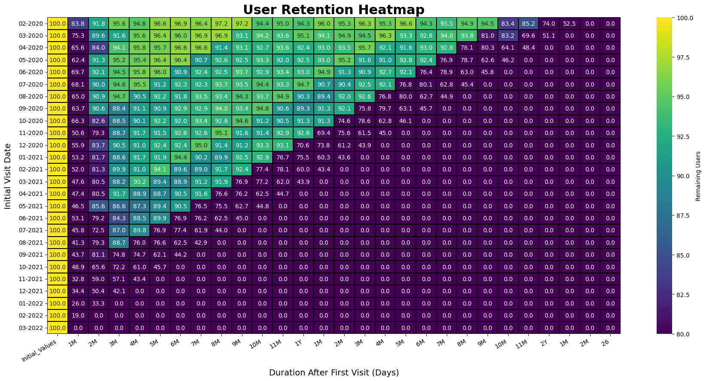
CHURN
MODEL
Heatmap
Final variables
Coding process and modeling (Notebook)

Slide 17
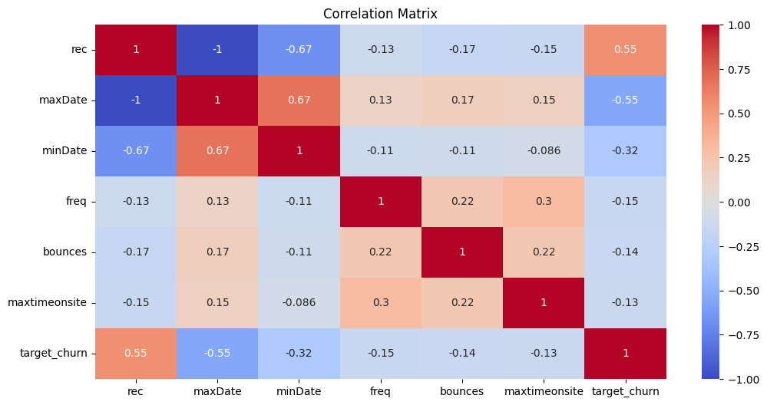
Development of the predictive model
Determining the Regressors
After doing some predictions and experiment with the data we came up with these regressors and then we calculated their correlation with target churn to know the
positive and negative variables.

Slide 18
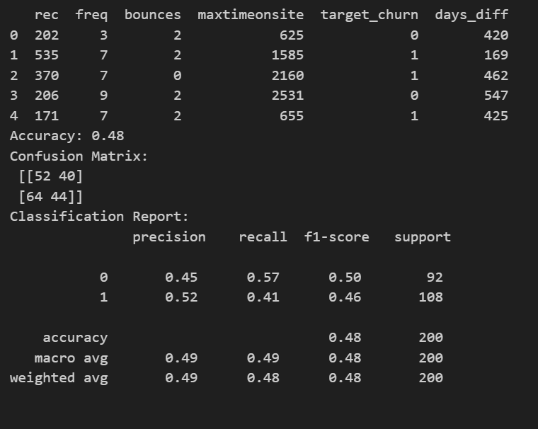
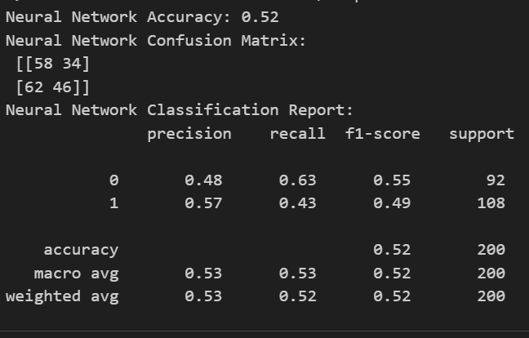
The predictive model
Improving accuracy
After doing some experiments, considering the number of datapoints I changed the regression model to a neural network and achieved higher accuracy.

Slide 19
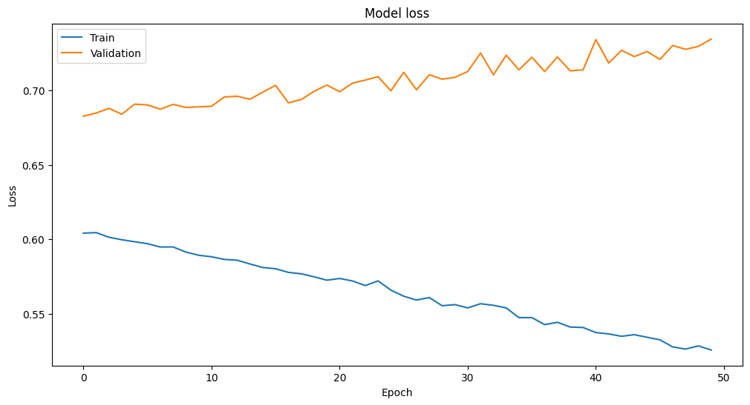
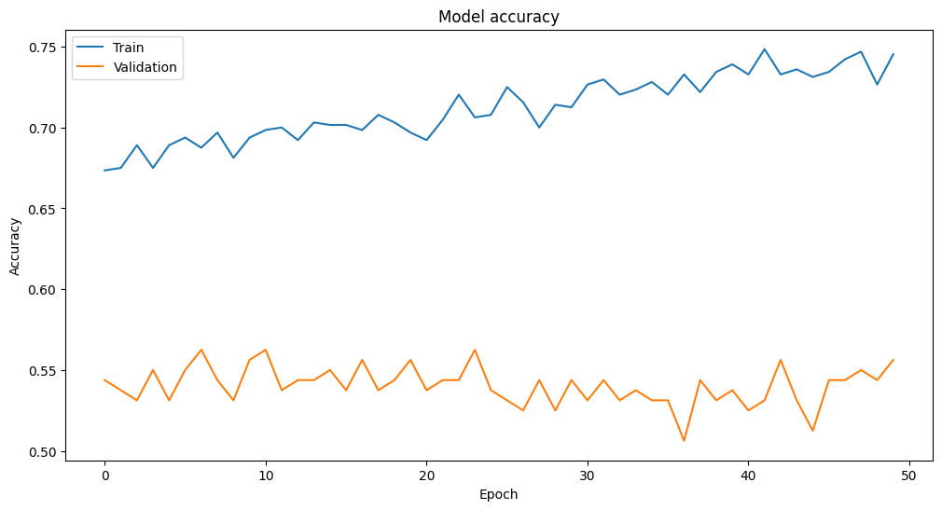
Performance of the
neural network
Loss and Accuracy
Although the results aren-t optimal, we see improvement with overall iterations and increase of Epochs. Improving the validation is something to aspire for.

Slide 20






FOR MORE OUT OF THE BOX IDEAS, HERE’S OUR OUT OF THE BOX TEAM
Quite Literally 👀
OUT OF THE BOX
OUT OF THE BOX
in/samaherbrahem
in/franco-bonifacini
in/mohammadhadishahhosseini
Pooya Sabbagh
github.com/SamaherUNIMI
github.com/Boni1995
github.com/mohmmadhadi
samaherbrahem.com

